Slide 1
Frontline.Live
Welcome Pack
v2.0

Slide 2
The way we work
This is a “how to guidebook” for working with Frontline.Live.
When the Covid-19 crisis first hit the UK we launched Frontline.Live. This is the working model we developed. It was a steep learning curve and we know you will help us improve it.
This is our gift to the world. Welcome to the Frontline.Live family. We look forward to growing Frontline.Live with you.

Slide 3
Contents
Section | This section covers
What is Frontline.Live? | The vision and mission of Frontline.Live, why it was created, the stakeholders we work with and the 4 pillars to our approach
How do we work? | Our guiding principles and behaviours, our teams and channels of communication
Our teams aligned to the 4 pillars | The structure, purpose and measures of success for each pillar
Technology | What we use and how its structured
Appendices | Job descriptions Process flows Comms playbook

Slide 4
What is Frontline.Live?

Slide 5
Vision
Mission
Frontline.Live harnesses the power of live, open data, to connect people in crisis with the resources they need.
By collecting, visualising and analysing data from suppliers & people in need, we show political and procurement bodies a more effective, more efficient and more human way of meeting needs in a time of crisis.
This decentralised, open source platform, & the way that it operates, will be improved over time.
Our mission is to make sure people on the frontline get the resources they need, at speed, at times of crisis to keep them safe.
We inform. We do not judge.

Slide 6
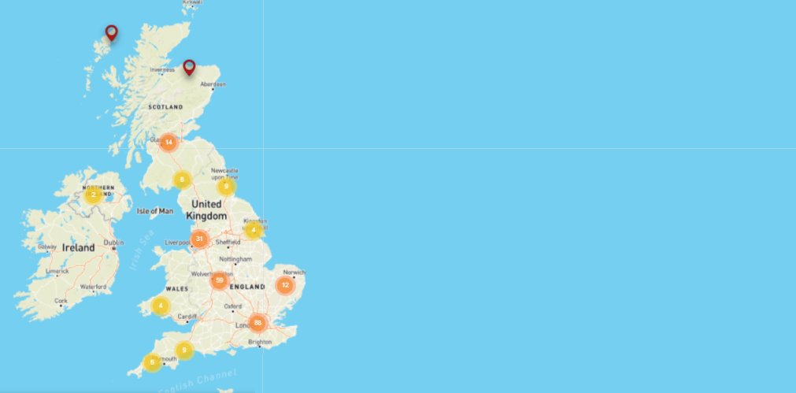
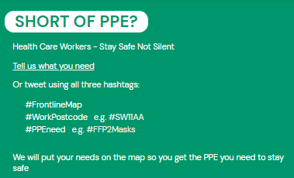
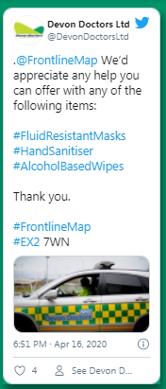
Why was Frontline.Live created?
During the first peak of Covid-19, many frontline healthcare workers didn’t have the protection they needed. They felt unsafe and no one was responding. These were not just numbers. Real lives were at stake. Existing systems were slow to respond. The lack of agility was palpable.
What does Frontline.Live do?
Frontline.live helps keep healthcare workers safe and give communities a way to provide support through a real-time response system.
The healthcare worker reports what they need, their request appears on a national map of real-time needs from the frontline. Anyone who can answer those needs can step forward.
Watch the video: https://www.frontline.live/intro
Notes:
What does frontline.live do? More about Value proposition etc

Slide 7
Who do we work with?
Our KEY stakeholders are PEOPLE IN NEED; we find and work with SUPPLIERS of PPE; we find and collaborate with any PARTNERS who can help us achieve our aims, and leverage THE PRESS and any other communications channels to get our message out there and to reach POLICY & DECISION-MAKERS …
Suppliers
Partners
People in need
Policy & decision makers
The press & influencers

Slide 8
Our approach
Technology
Open source location based technology, that allows needs & supplier data to be plotted, aggregated and visualised
Communications
Making sure compelling stories get to the right people to drive engagement
Keeping people safe during crisis
Needs matching
Getting the right resources to the right people at the right time
Partners
Building strategic relationships for credibility & reach across;
the media
professional organisations
strategic suppliers
Continuous cycle of improvement manned by volunteers

Slide 9


Frontline.Live teams
Director
Tech
Supplier QA
UX Research
Content
Data Analysis
Needs Matching
Partnerships
Media
Tech
Needs Matching
Partnerships
Communications

Slide 10
What does success look like?
People in need
People engage with the message and submit needs on Frontline.Live
Needs are matched within 24hrs
Suppliers
We source the required PPE
An increasing amount of non - traditional suppliers as possible to sign up on the Frontline.Live site
The Press
There is awareness of Frontline.Live
Stories of a different way to solve crisis.
Policy & Decision-makers
Data informs changes in fit for purpose policy
Our focus on safety: We will have robust, transparent and continuously improving processes in place to ensure that resources made available to people in need, is of the required specification to answer their needs

Slide 11
How will we achieve success?
Our mission is to connect people at all levels affected by any crisis in real time to the resources they need.
This open source platform will be used and improved over time by us & by people around the world to create their own rapid response platforms for any ongoing crisis.
We inform. We do not judge.
Drive awareness within frontline healthcare worker community
Develop strategic partnerships to amplify and help us hit our targets
Partner with influencers to actively engage with real time data reports
Regular coverage in mainstream media and press
Notes:
Needs a bit more - to encompass EVERYTHING

Slide 12
How do we work?

Slide 13
Our teams adhere to 6 guiding principles...
Single mindedly focus on the safety of the people in need
We inform, we don’t judge
Everything can be better - always
Democratised, decentralised, open, and accessible data informs better decision making and problem solving - “If you can see the shape of a problem, you can solve the problem”
We measure to make sure we are optimising impact
Everyone is equal, every voice matters

Slide 14
… & 7 behaviours
We look for these behaviours in our volunteers & make sure they know what is expected of them
Dependable - “I show up when I say I will”
Accountable - “I am happy to report on measures”
We help each other to succeed - Always “Yes, and” never “no, but”
Open and Transparent - “We share, collaborate and co-create”
There is no US, it is all about THEM - “We leave our ego at the door”
Go hard on problems, not people - “No blaming, just solving the problem”
Proactive and curious - “Always looking to learn and improve”

Slide 15
The Operations team
Heads of each team make up the Operations Team (+ our volunteer manager)
Director
Tech
Supplier QA
UX Research
Content
Volunteer Management
Data Analysis
Needs Matching
Partnerships
Media
Tech
Needs Matching
Partnerships
Communications

Slide 16
Operations team
These are the team leaders that are responsible for the day-to-day running of Frontline.Live.
Purpose
Ensure consistent communication of priorities to all teams
KPI updates
Agree priorities
Short status share from each function
Raise and remove blockers
Measures of success
Progressing KPIs
All volunteers know their role and impact
Train and recruit volunteers effectively

Slide 17
Operations team communication
The Ops team meets through stand ups on zoom
Daily although in quieter periods 3x weekly on Mon/ Wed /Fri
Priorities, goals and tasks are allocated and managed through trello
Emergency comms are handled via whatsapp
Team leaders are accountable for communication with their teams

Slide 18
Our distributed working model
Agree priorities
Progress updates
3-5x weekly
Celebrating successes and priorities
Fortnightly
Ongoing
Ongoing
Ongoing
Ongoing
Operations Team meetings
Via: Zoom
Frontline.Live town halls
Via: Zoom
Task management
Via: Trello
General comms
Via: Slack/ Whatsapp
Emergencies
Via: Whatsapp
Documents
Via: Google drive
Notes:
Add something about a distributed set-up/over borders / agile etc - explain it !

Slide 19
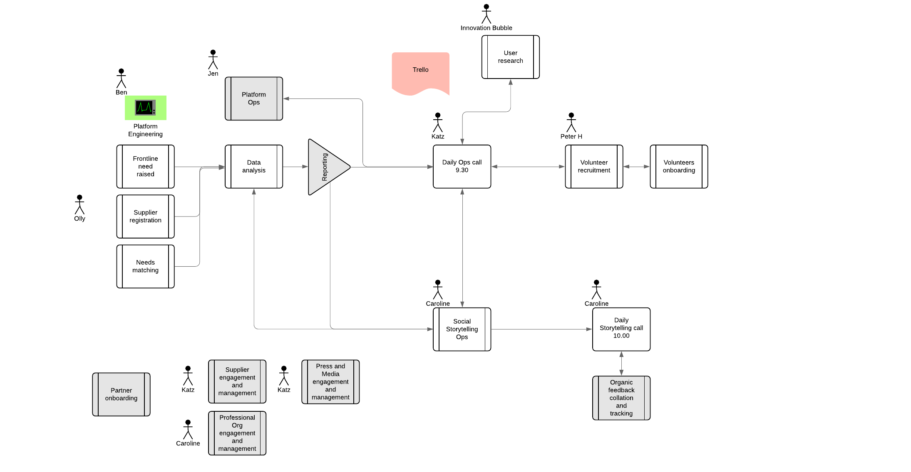
Frontline.Live overview... how we run it...
Notes:
Take names off it and put “icons” - put in appendix instead?

Slide 20
The 4 Pillars & Our Teams

Slide 21
In this section we describe in more detail
The purpose of the teams needed in each pillar
How these teams are structured
An indication of the size of teams needed
Brief job descriptions with more detail in the appendix

Slide 22
Technology
Technology team structure
Keeping people safe during crisis
Engineering
Product
Tech Manager
Product design
Platform Strategy
Data & Data Analysis

Slide 23
Technology
Tech team
Keeping people safe during crisis
Purpose
Continuously improve the open source platform that surfaces demand and supports supply
Replicable and extendable platform that can be part of a rapid response system for crisis
Data and reporting capabilities that generates actionable insight
Measures of success
Usability and stability of the platform
Ease of replication
Dwell time & bounce
You will need:
A team of 1-2 people who can pick up the open-source code and manage the platform and 1-2 people who can run analyses and produce dataviz and reporting to tell the story from the data collected

Slide 24
Needs matching - team structure
Keeping people safe during crisis
Needs matching
Need raiser engagement
Needs matching
Manager
Supplier engagement
Need matching
& supplier strategy
Supplier QA

Slide 25
Needs matching team
Keeping people safe during crisis
Purpose
Making sure that the right supplies get to people quickly !
To connect every frontline need reported with the suppliers who have it
Own the day to day relationship with people with needs & suppliers
Identify suppliers who could become partners
Be a channel for feeding potential story-worthy content to comms team
Measures of success
Time taken to add new needs to map/ begin needs matching/follow up
% needs matched/ in progress
Number of story worthy content found/ passed on
Needs matching
You will need:
to have a team large enough to fill shifts across the week who have high attention to detail, are results focused and are strong communicators

Slide 26
Comms
Communications team
Keeping people safe during crisis
Press/Media
Manager
Content creator(s) and curator(s)
Editorial strategy
Community manager
Social Media
SoMe analyst(s)
Designer(s)
Influencer manager(s)

Slide 27
Comms
Communications team
Keeping people safe during crisis
Purpose
Generate awareness, grow the community, inspire crisis focused action across 3 stakeholder groups
Define communication strategy, draft briefs with clear KPI’s and target audience.
Create engaging and targeted communication and content
Develop social media strategy and set-up on platforms
Measures of success
Targeting
Reach
Engagement
Share of voice
You will need:
People who can craft compelling messaging and stories, people who can engage in conversation with audiences, people who can track, analyse and develop insights.
Notes:
Add in Playbook (link)...

Slide 28
Partnership team
Keeping people safe during crisis
Partners
Pro bono charity
Suppliers
Manager
Paid for suppliers
Partnership Strategy
Supplier quality assurance
Professional Organisations
Press/Media Partners

Slide 29
Partnership team
Keeping people safe during crisis
Purpose
Create and manage partnerships with suppliers and professional organisations that are aligned to the Frontline.Live mission
The day-to-day contact with suppliers and partners may be carried out by other teams depending on subject matter
Maximising the partnership potential
Measures of success
Numbers of new partners & potential partners
Longevity of support
Increased level of support
Partners
You will need:
A team who can follow-up on leads to build relationships, form partnerships and maximise the potential of those relationships

Slide 30
What technology do we use?

Slide 31
Technology details
Open source on GitHub
Techstack
Azure -DevOps
MS aspnetcore
Data tooling
Short term/proto typing ; Excel
Longer term; Tableau and/or build in Front End (In progress)

Slide 32
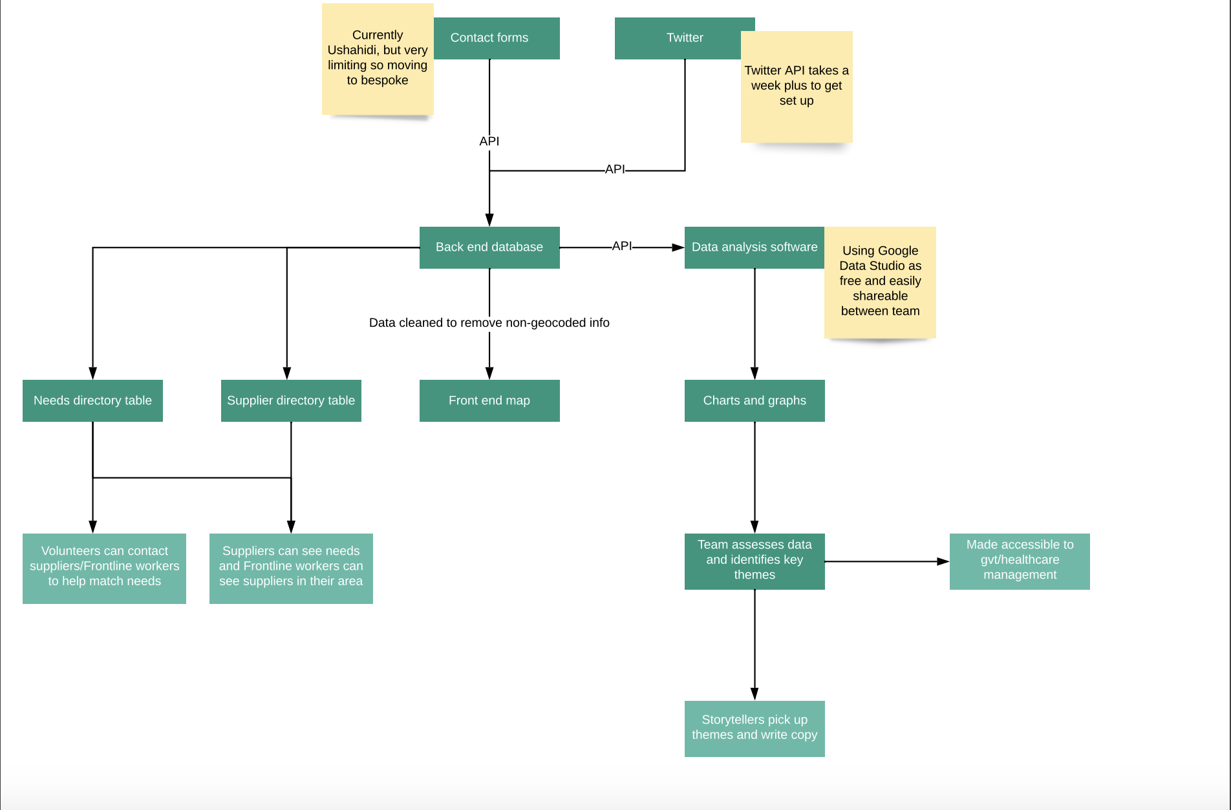
Technology & data flow
Notes:
Say what we are looking at !!!

Slide 33
Appendix - Job descriptions

Slide 34
Role | Job summary | Responsibilities & duties | Experience & skills
Director | A motivational, strong leader who can orchestrate the programme during the crisis | Created and communicate a compelling vision Lead on product, comms and partnership strategy Ensure roadmap is aligned with vision Keep teams aligned and motivated Recruit the right people for the right jobs Lead on fundraising Keep an eye on KPIs | Passionate visionary who can execute A well connected connector Adaptable and flexible A motivator who embodies frontline principles and behaviours Business planning and fundraising
UX researcher | You are responsible for finding out how the platform can be optimised in terms of its user friendliness, content understanding, user experience. This can be achieved by interviewing or surveying the target audience group. | interviewing target audience; running survey with target audience, analysing data, updating team on insights | This role is ideal for someone who's curious about other people's opinions and experience, putting oneself's opinions in the backseat. You're comfortable and skilled at interviewing people by using non biased and leading questions in order to not influence the interviewee. You have understanding of UX principles and are capable to analyse data and report these back in a digestiable manner for the team.

Slide 35
Role | Job summary | Responsibilities & duties | Experience & skills
Needs Matching Team Leader | You are responsible for onboarding, managing, motivating & inspiring volunteers who will connect frontline worker who needs equipment, with the suppliers who have it. | - Manage needs matching team & needs matching process - Manage the supplier quality assurance process - Attend daily ops meeting - Ensure shifts are covered appropriately - Support and follow up on needs matching volunteers queries - Own the preferred supplier list & identify potential partner worthy suppliers - Own the FLL email service - Identify & confirm story worthy insight on suppliers and needs raisers | - Able to onboard, motivate, support and inspire a team of volunteers - Highly results driven - Strong communicator both internally and externally - Hands on - Resilient & determined - Structured, organised with a high attention to detail
Needs matching volunteer | You are responsible for connecting every frontline worker who needs equipment, with the suppliers who have it. | - Validate & add suppliers and needs to the map - Offer suppliers to &/or approach suppliers for; the need raisers in order to meet their needs - Foster and build relationships with suppliers and needs raisers - Update the list of preferred suppliers - Monitor the FLL email service - Identify story worthy insight on suppliers and needs raisers | - Results orientated & driven - Resilient & determined - Attention to detail - Comfortable communicating with need raisers and suppliers over phone and email

Slide 36
Appendix - process flows

Slide 37
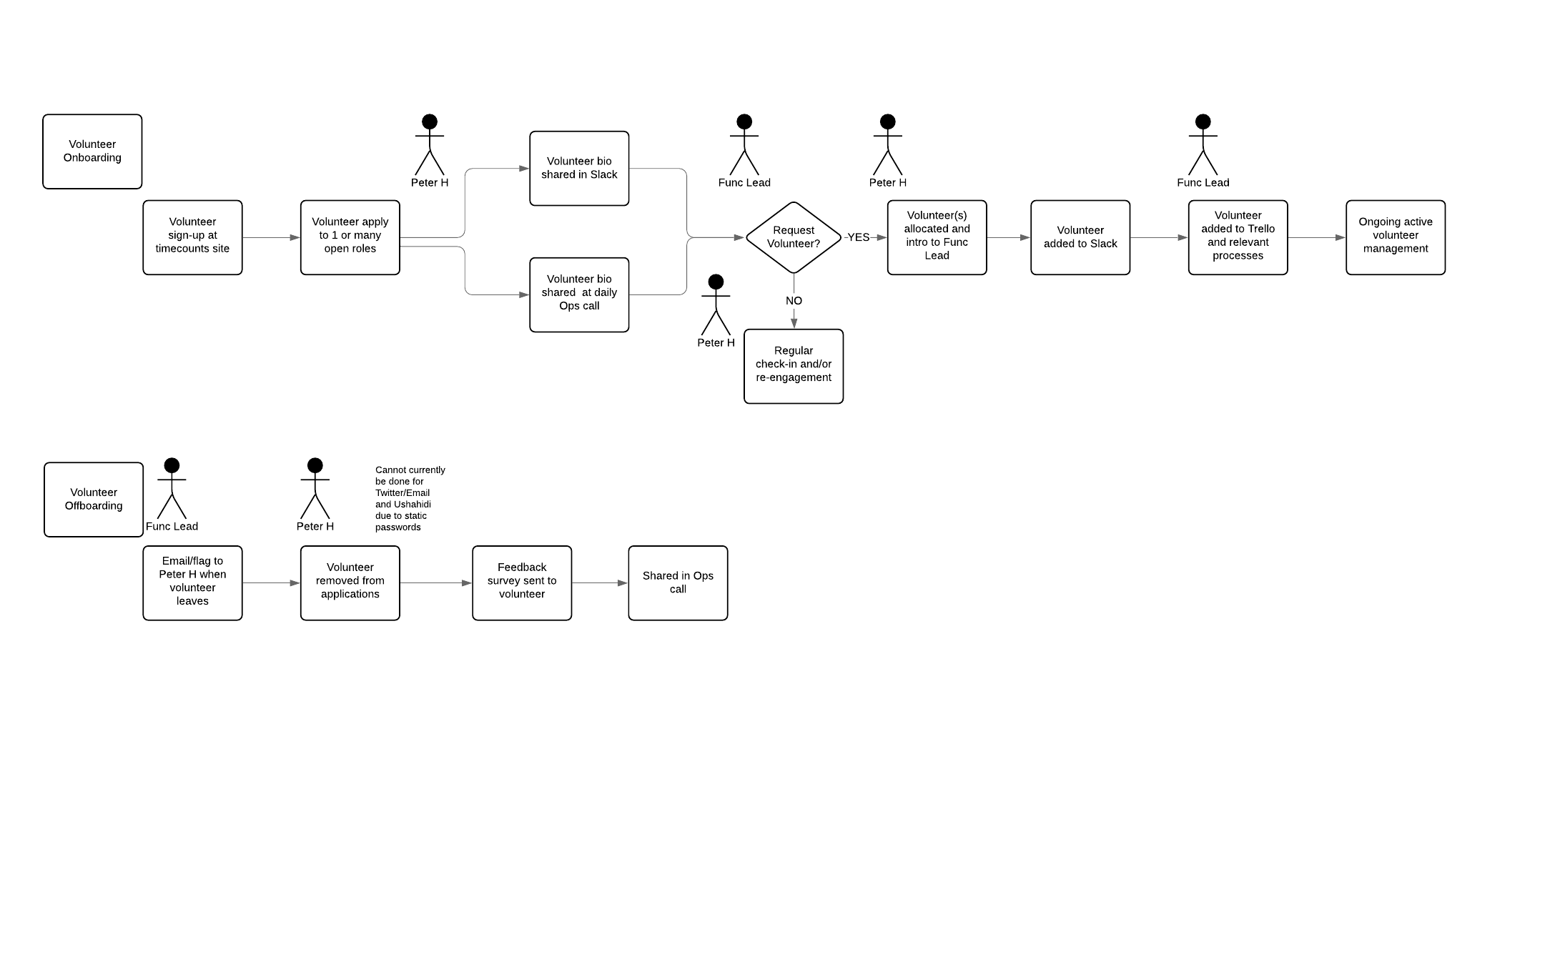
Volunteer process

Slide 38
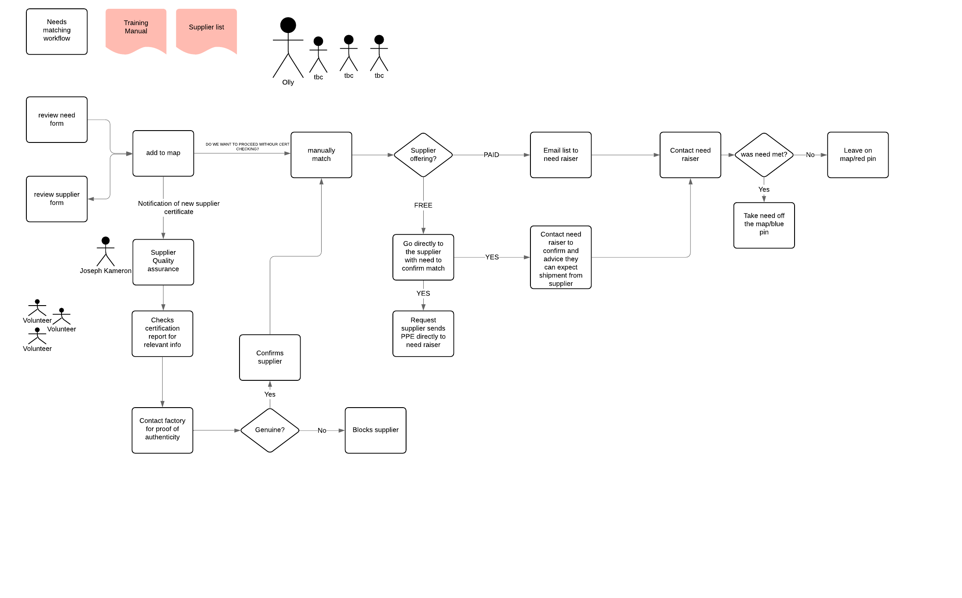
Needs matching process

Slide 39
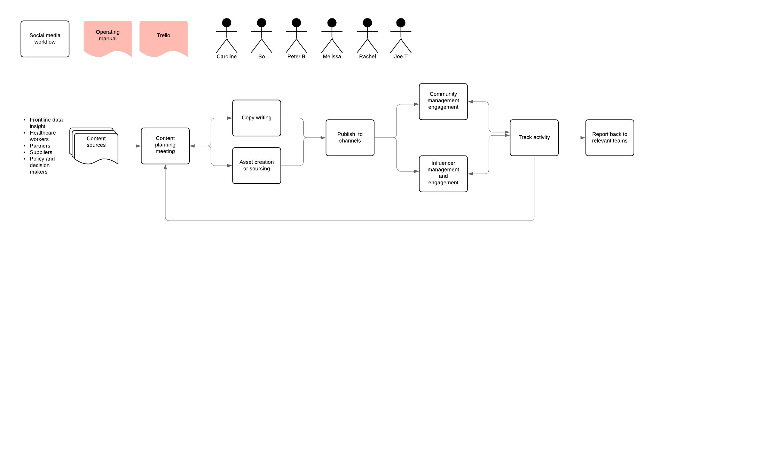
Social media process

Slide 40
Appendix - Communication & Engagement playbook

Slide 41
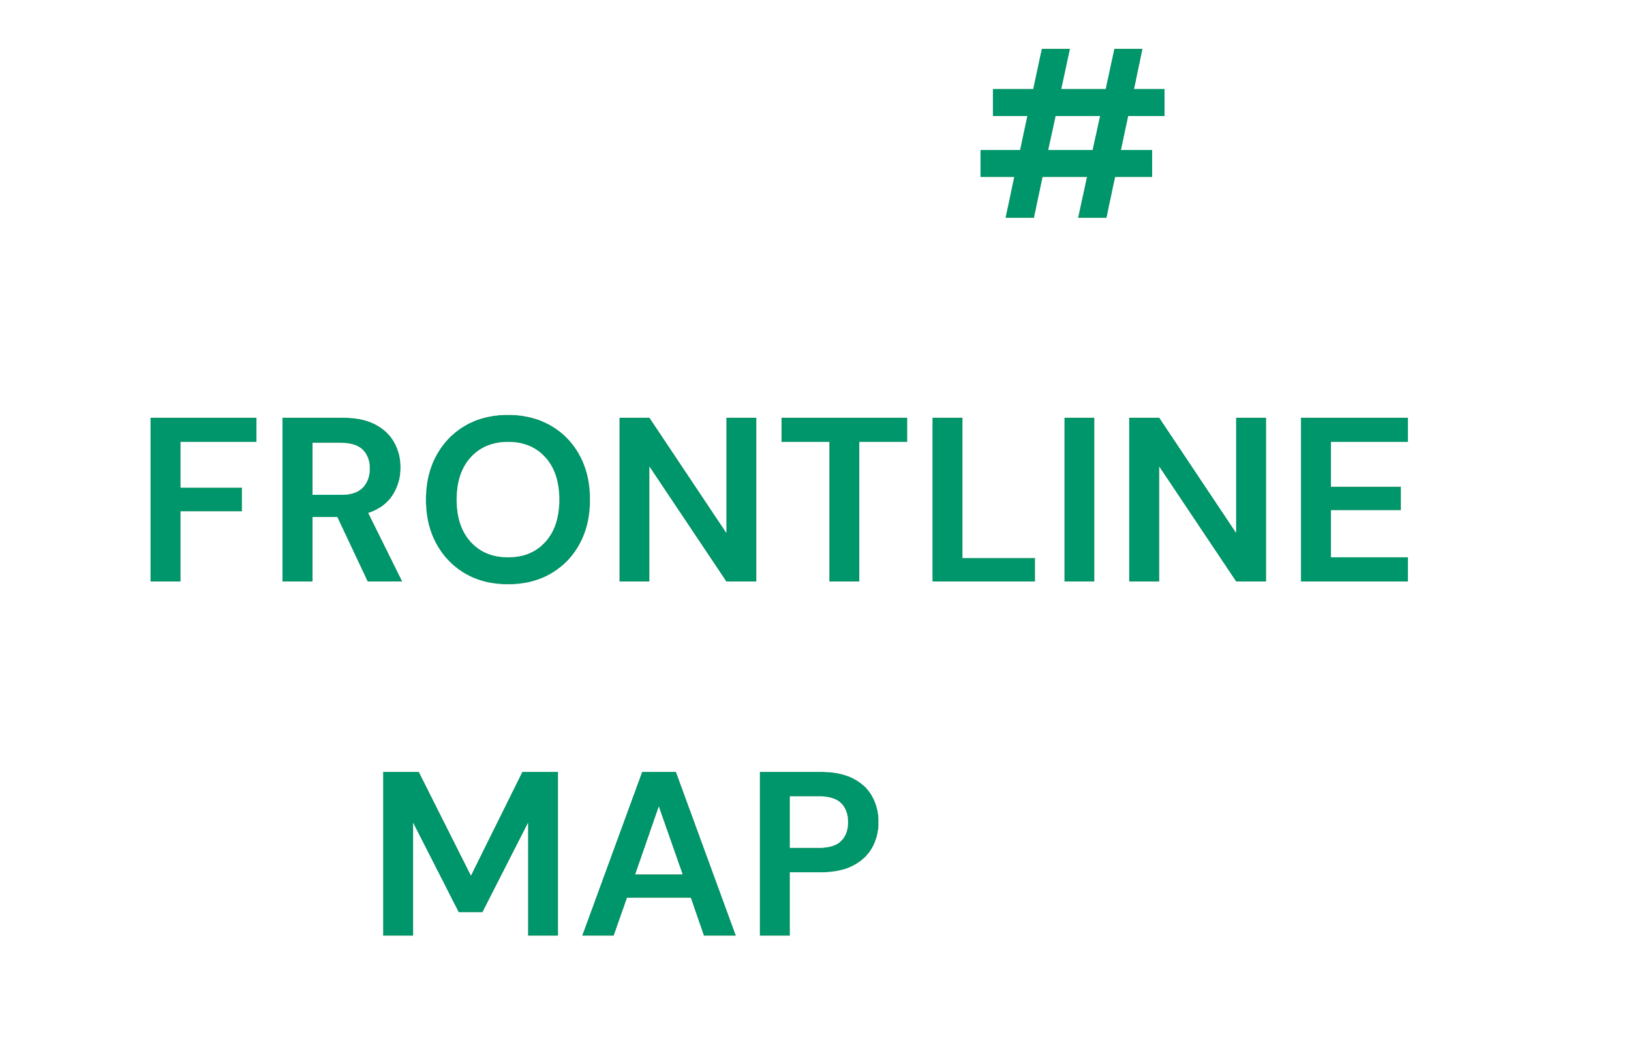
Frontline.Live Communications and Engagement Playbook
August 2020

Slide 42

What is this book?
This playbook is designed to help volunteers working on frontline.live (FLL) understand what we’re all doing, how we’re doing it, and why it’s important.
It contains all the tips and tools to help you make frontline.live successful
One playbook for the whole frontline.live community.
We’re all on the same page, and we’re in this together.

Slide 43
Mission
Vision
Our mission is to keep frontline workers safe by giving businesses and communities the opportunity to provide necessary resource in a timely way.
Frontline.Live harnesses the power of live, open data to connect healthcare workers with the resources they desperately need.
By collecting, visualising and analysing live data from frontline workers, we provide a more effective, efficient, and human way of meeting needs in a time of crisis.

Slide 44
The Origins of Frontline Live
In March 2020, there were over 25,000 mentions of the need for PPE on Twitter. The papers and news reported the lack of basic protection in our hospitals, from the people on the very frontline of our healthcare system.
It was very clear that those whose job it is to protect us, needed protection. At the same time, there were thousands of social posts from people who wanted to help, but couldn’t see where or how. This is why we launched frontline.live, to connect the need with the supply.

Slide 45
Key objectives
Raise awareness about Frontline Live so Health Care Workers (HCW) and non-traditional suppliers know what the platform does and how and when to use it
Position Frontline Live as THE authentic voice of the HCW community - real people, real stories, real advice, real action.
Engage the HCW community to participate in public safety and health practices
Strike a balance between raising awareness i.e. keeping safe and the power of solidarity and collective agency.

Slide 46
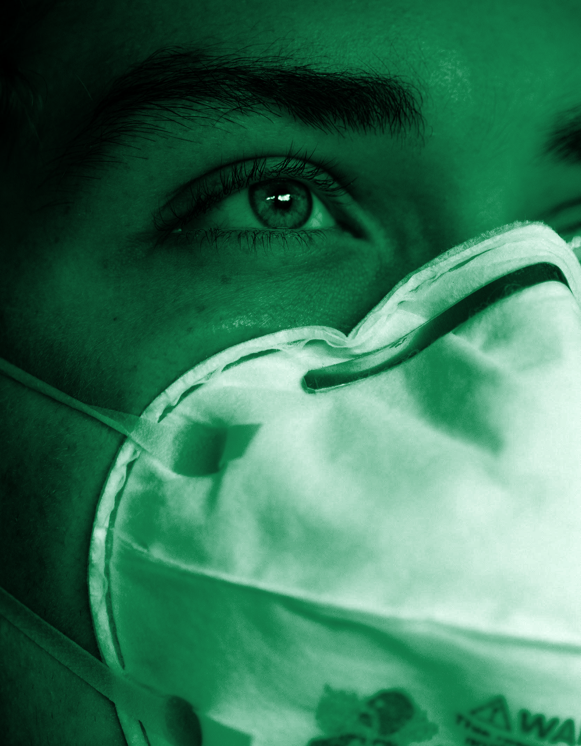
We’re addressing four distinct groups of users, each with their own concerns and needs.
Healthcare workers - we’re giving frontline workers a voice.
Suppliers - enabling non-traditional suppliers to respond in real time to reported needs.
Press and Institutional Leaders - giving government organisations and policymakers a concrete example of how to empower frontline workers in an agile, resilient way.
UK Citizens - sharing actions, data, information from Frontline and advice from Frontline workers.

Slide 47
Giving frontline workers a voice
Elevate frontline workers as the voice of authority throughout the pandemic - going beyond the need for PPE.
Engage and spark conversation about support, solidarity and collective agency for frontline workers and the communities they serve.
Create an awareness that we need to protect ourselves, to protect others and to protect the frontline workers.

Slide 48
Message(s)
We are not out of the woods yet. The same problems still persist.
Protect the people who care for the people we care about.
Frontline Live is by the people, for the people.

Slide 49
What
Why
Show the problems. Frontline workers are suffering alongside their patients, (and they’re short of PPE).
Tell the undeniable truth about Covid-19, from Frontline Workers.
Convey how to make smarter choices that not only keep you safe, but all of those around you.
Build trust for Frontline.live.
Give a voice to the people who have endured the worst of aspects of the pandemic
Keep everyone updated and informed
Honor Frontline Workers and uplift civic responsibility

Slide 50

Activation Strategy

Slide 51

Frontline is here to elevate the heroic and real life experiences from frontline workers to remind us all what it takes to take care of each other.
We invite frontline workers to put their needs on #FrontlineMap, connecting them to PPE suppliers
But their voices have been silenced by a fatigued news cycle.
Which is why we ask frontline workers to Stay Safe, Not Silent.
#FRONTLINEMAP
Notes:
Using web based technologies, the platform invites health workers to tweet their needs, and then maps their tweets so local NHS procurements and communities can rally round to make sure they get what they need, keeping them safe while they protect and treat us and our families.
Twitter will be the hub used to match frontline workers needs and suppliers able to fulfil them. Using the #frontline along with what they need and their postcode, they will be added to an uptodate map of the UK.

Slide 52
Primary Stakeholders: Frontline Workers
Our job is to make healthcare workers feel safe enough to share their PPE needs.
What
#FrontlineMap elevates voices from the frontline, educating UK citizens how to best care for themselves and each other during the #Covid19pandemic, and give support to frontline workers by making sure they get PPE to keep us all safe.
How
Frontline workers share a video or photo and a story of their lives on the frontline...the highs and lows….giving people sound instruction on how to best stop the spread of Covid. We’ll post their stories across social media, and on the map so potential suppliers so that we can be aware of hot spots. Our job is to make healthcare workers feel safe to tweet their stories so that we can help keep them safe..
Communications Strategy:
The key focus is communication to those most at risk from higher viral loads; health care workers, whether that be in hospital trusts, community hospitals, care homes, GP surgeries, or dentists.
Health care workers have seen it all. People at all levels have reported PPE needs, from senior doctors in hospital trusts to porters in care homes.

Slide 53
Secondary Stakeholders: Non-Traditional PPE Suppliers
Our job is to engage, promote, and inspire organizations and communities who are finding fixes.
Communications Strategy:
The key focus is to identify, support, and promote the growing community of small and non-traditional suppliers that desperately want to help. We’re making it easier for them to find out what most urgent needs are and where they need to go.
For example, we’re in contact with fashion designers who have pivoted to make gowns, world-class architects who have designed and made protective visors, and a teacher who is using a 3D printer to generate protective masks.
What
#frontlineMap provides a platform that promotes, engages, and inspires non-traditional PPE solutions to keep our frontline workers safe… and encourages others to do the same.
How
We use film and photo to highlight matches made from supplier to requester on Frontline.Live and social media plaforms to show case the emotional impact made in part by Frontline Live to encourage support by the community.
.

Slide 54
Tertiary Stakeholders: Press, Procurement, Policy
Our job is to make sure that they see, share, and stay informed by Frontline.Live activity and reports.
Communications Strategy:
The key focus is to drive engagement around a regularly published report that aggregates critical findings and emerging patterns.
We are effectively building a signposting platform to support and augment traditional procurement, so decision-makers can make more informed decisions, to keep our frontline heroes safe.
What
We will share the most engaging stories from frontline workers and suppliers along with a regular report that provides analytics reports around citizen engagement and perceptions around supply and demand patterns across supply type, organizational type and level, geography, and careworker type and level.
How
Identify influencers and direct relevant messages to them so that they will sign up for Frontline.Live report. To receive regular reports from Frontline.Live they should email frontline@wearebeep.com with FRONTLINE LIVE REPORT in the subject line.
We inform. We do not judge.

Slide 55

KPIs

Slide 56
What does success look like?
Having no engagement could mean a signal of success.
But it could also mean If we don’t get tweets from frontline staff, that means they don’t need any equipment. That’s the ultimate goal of this project: to make sure they have everything they need to be able to carry out their jobs safely, and that we as concerned citizens support them.
We need to make sure our message can be seen by frontline staff, by businesses and individuals that can provide them with needed equipment, and by the press, procurement professionals, and government policymakers.
We’re pursuing these goals through organic media and sharing.

Slide 57
What does success look like?
Frontline Workers
Get more doctors and nurses to engage with key messaging, and tweet or submit their needs to frontline.live
Get more people to engage with us and share our service
Suppliers
Get as many non- traditional suppliers as possible to sign up on the Frontline.Live site
Get as many people as possible to share content to get suppliers to sign up
Press, Procurement
& Policy
Earn coverage in mainstream media and press
Get more people signing up and referencing realtime report data
Spark changes in policy to support rapid response to supply and demand

Slide 58
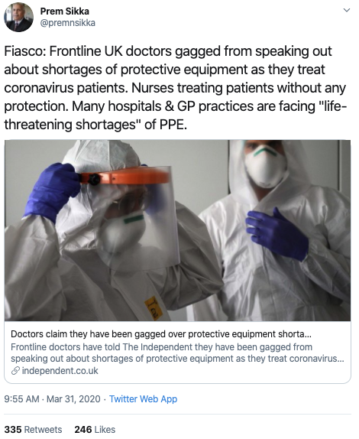
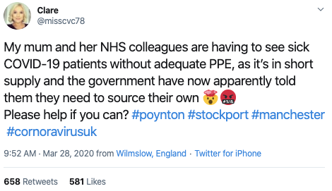
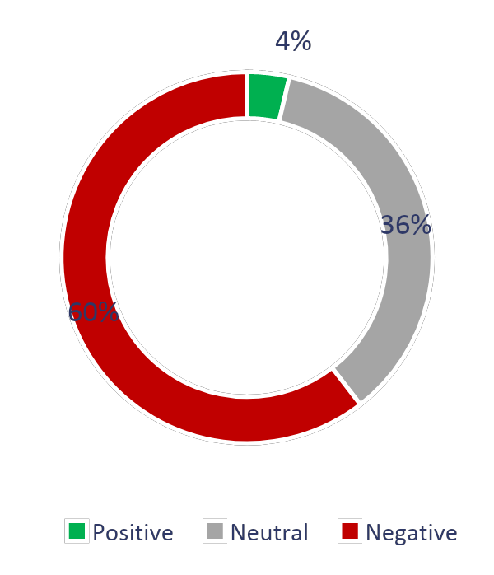
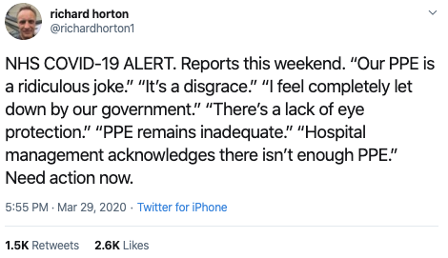
Key PPE Insights
We found over 25k mentions of the need for more PPE equipment for NHS frontline staff during March.
We found that most tweets by NHS workers were about concern for their safety when treating patients with the coronavirus.
But we also found thousands of tweets from people wanting to help. These included people pooling resources to develop and manufacture PPE and ventilators, to help address chronic shortages.

Slide 59
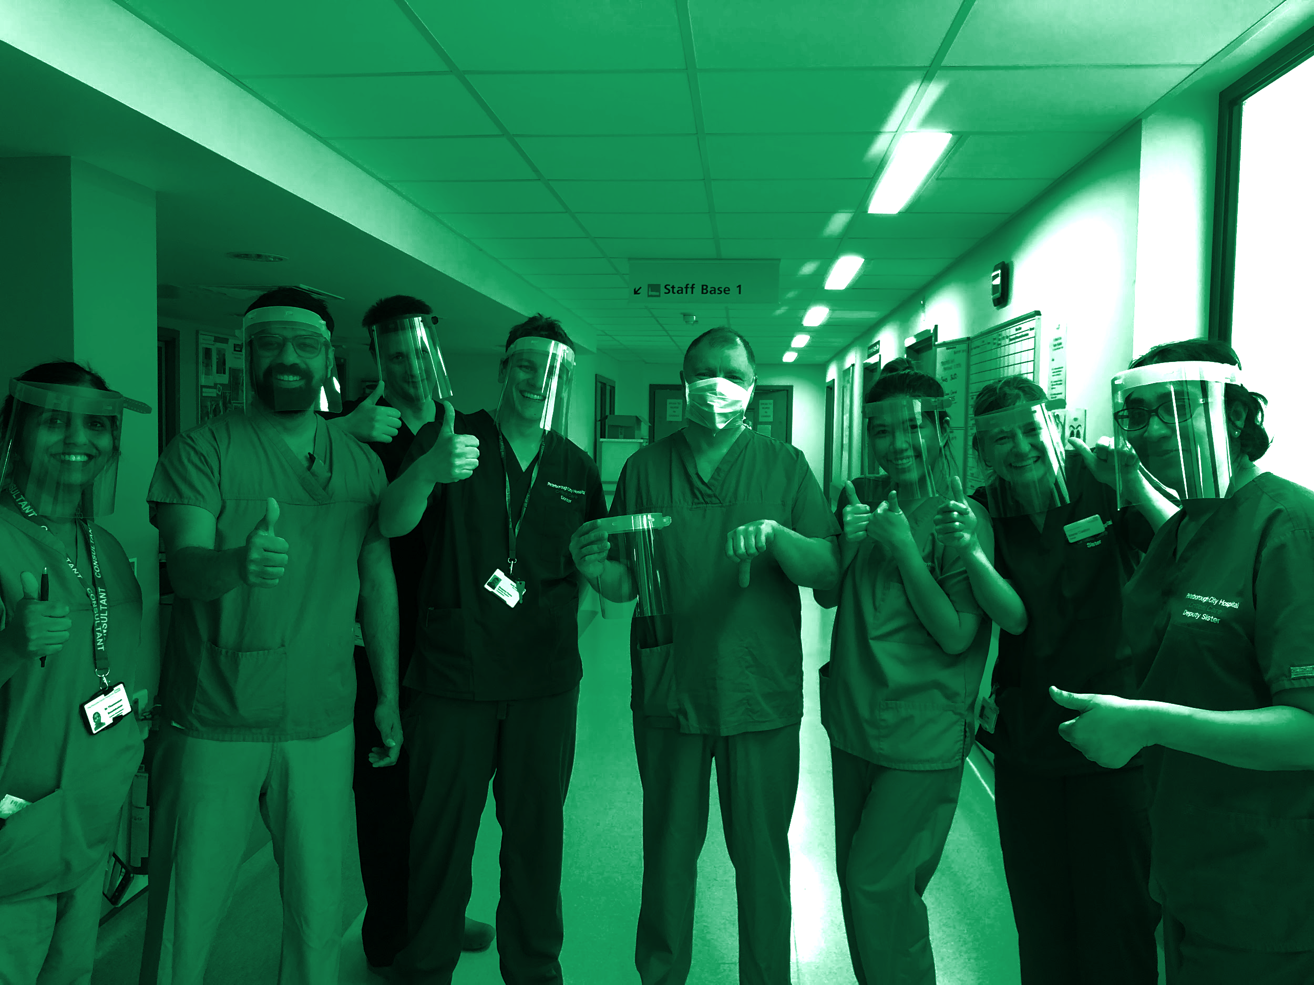
Engagement Response Guide

Slide 60
TONE OF VOICE
EXAMPLES
CLEAR
HUMBLE
Healthcare worker Twitter:
#frontline workers: Tweet a pic with #frontlinemap #workpostcode #PPE if you’re short of masks, visors, ventilators etc. Our programme links you with nearby suppliers.
Suppliers Twitter:
Here’s the Birmingham Makers Club, and their suite of 3D printers that just finished fabricating 200 face shields. Who needs them? #PPE #InThisTogether
Press, Procurement, Policy Twitter: (TBC)
@RCSnews Thank you for subscribing to @frontlinemap’s insights report, and supporting the safety of all healthcare workers #PPE #InThisTogether
#FrontLinemap does great things every day. No need to dress it up, just say what’s happening.
The people using our service are the heroes, we’re just the connector. Celebrate them, not us.
OPTIMISTIC
CALM
It’s OK to be genuinely happy about what’s happening here. Focus on the progress being made.
It’s stormy out there; be the lifeboat. Avoid hyperbole, slang & gratuitous exclamation points.
SELF-ASSURED
HUMAN
Think of how a veteran nurse talks: confident, assured, unflappable. Use complete sentences, with punctuation.
Some readers are health care pros, some are makers, some engaged volunteers. Speak in a real, human voice they can all understand.

Slide 61
MESSAGING SAMPLES
Content Type | Platform | Sample Text
General Announcement | Twitter | #frontline workers: Tweet a pic with #frontlinemap #workpostcode #PPE if you’re short of masks, visors, ventilators, etc. Our programme links you with nearby suppliers. Are you a frontline health worker who needs #PPE? http://frontline.live is a community of volunteers working to get healthcare workers the #PPE they need. Tell us what you need by going to http://frontline.live Everyone else, help by sharing! #FrontlineMap
Highlight Frontliners | Twitter | Glasgow Royal Infirmary, with 1000+ beds, is a cornerstone of Scotland’s #coronavirus response. These six nurses save lives on a daily basis.
 | Insta/FB | [photo of building and/or staff] - The Glasgow Royal Infirmary has been treating the sick and guarding the health of Glaswegians since 1794. So this isn’t the first pandemic it’s seen (and it probably won’t be the last). The Infirmary’s 1000+ beds are tended by a small army of nurses, doctors, technicians, porters, and other caregivers—they’re the main reason most of the COVID-19 patients admitted eventually make full recoveries. But doing their job takes resources—especially personal protective gear like masks, face shields, scrubs, and gloves, which are in constant short supply. You can help support the staff of Glasgow Royal Infirmary in a number of ways. If you’re a manufacturer or distributor of PPE, or an individual or community group that’s making PPE to donate, you can get in contact with them on the map at Frontline.live. And if you’re not, please help us spread the word, so that PPE providers across the UK can get in touch with the frontline workers who so urgently need them.

Slide 62
MESSAGING SAMPLES
Content Type | Platform | Sample Text
Highlight Suppliers | Twitter | Here’s the Birmingham Makers Club, and their suite of 3D printers that just finished fabricating 200(!) face shields. Who needs them? #PPE #InThisTogether
 | LinkedIn | PPE is on its way. Plane loads of it. Fitout.global is an approved PPE supplier to NHS England, Scotland and Wales, processing large orders of masks, gloves, scrubs, and more. It’s been especially tricky because there’s a lot of counterfeit PPE flooding the market at the moment, meaning that every order has to be carefully verified before it can be confirmed and shipped. NHS procurement teams are working diligently under incredible pressure, to process them. And it’s working — millions of masks are arriving every day, ready to be distributed by the MOD.
Celebrate Connections | Twitter | Nurses at Glasgow Royal Infirmary, unboxing a shipment of masks & scrubs from [provider]. Huge thanks for the much-needed #PPE, and to the #frontlineheroes putting them to good use.
Good News | Twitter | Student nurses from 35 UK universities have signed up for six-month hospital placements, immediately adding over 5500 new workers to the #frontline. #InThisTogether
 | Insta/FB | Scottish craft brewery BrewDog has switched much of its line to producing “Punk Sanitiser” hand sanitiser — which they’re distributing for free. Like many UK businesses, BrewDog is dealing with the #COVID19 downturn by pitching in to curb the deadly virus.

Slide 63
STYLE GUIDE
Style Guide
Be warm, clear, and human in posts and responses
Always respond ASAP to all tweets and communication to and from frontline.live, acknowledge their engagement
Get the vital information across
Avoid complex sentences, stick to one idea or concept per post
Use contractions to save characters - ‘we’re’ NOT ‘we are’, ‘you’re’ NOT ‘you are’, ‘can’t’ NOT ‘cannot’
Avoid metaphors, similes and other figures of speech
Refrain from using clunky grammar and caveats
Remember we are here simply to help facilitate the solution to a problem.
Talk as you would to a neighbour who you’re trying to help with something.
Key Hashtags for publicising:
#PPE
#frontline / #frontlineheroes
#opendata
#InThisTogether
#StaySafeNotSilent
#InItTogether And we always encourage providers and frontliners to use #frontlinemap to alert us to their needs and offers.
Remember we are here simply to help facilitate the solution to a problem.
Talk as if you would to a neighbour you were trying to help with something.
Key Hashtags:
#PPE
#frontline / #frontlineheroes
#opendata
#InThisTogether
#frontlinemap

Slide 64
SAY THIS
NOT THIS
Style Guide
#frontline workers: Tweet a pic with #frontlinemap #workpostcode #PPE if you’re short of masks, visors, ventilators, etc. Our programme links you with nearby suppliers.
Glasgow Royal Infirmary, with 1000+ beds, is a cornerstone of Scotland’s #coronavirus response. These six nurses save lives on a daily basis.
Here’s the Birmingham Makers Club, and their suite of 3D printers that just finished fabricating 200 face shields. Who needs them? #PPE #InThisTogether
Nurses at Glasgow Royal Infirmary, unboxing a shipment of masks & scrubs from [provider]. Huge thanks for the much-needed #PPE, and to the #frontline heros putting them to good use.
Are you a frontline health worker who needs #PPE? http://frontline.live is a community of volunteers working to get healthcare workers the #PPE they need. Tell us what you need by going to http://frontline.live Everyone else, help by sharing! #FrontlineMap
#UKhealthcareworkers: tweet your need! Whether it’s masks, visors, ventilators or all of the above. Our programme tracks needs and sends them to suppliers every day. [too choppy, uses low-volume hashtag]
Look at these rockstars! Nurses at the Glasgow Royal Infirmary are on the #frontline every day, saving lives. Who wants to hook them up with some #PPE? [too informal]
The UK is in full crisis mode. These nurses are the #frontline. Many work 12 hour shifts. Haven’t seen family in weeks. What are you doing to help? #PPEshortage [too pessimistic, dramatic & problem-focused]
Another successful match! Our innovative service has gotten 1000+ masks & scrubs to these nurses who desperately need them. #PPE. Check out frontline.live for more examples to keep tabs on all the action! [too self-congratulatory]
People are dying, and our #NHS #frontline heroes can’t get the #PPE they desperately need! Where is the UK government in all of this? We should demand more! [too political, focuses on blame rather than solutions]
Remember we are here simply to help facilitate the solution to a problem.
Talk as if you would to a neighbour you were trying to help with something.
Key Hashtags:
#PPE
#frontline / #frontlineheroes
#opendata
#InThisTogether
#frontlinemap

Slide 65
ENGAGEMENT DO’S
ENGAGEMENT DON’TS
Style Guide
Reply to each tweet in need of equipment using their name at the start of a response or build it into the reply
Use the pre-approved messages in the FAQS as a guide
Be helpful and positive in your posts/responses
Write in the first person by using we, us or our
Check spelling and grammar
Engage with trolls. Decide whether the person is genuine or not. Drawing the attention of angry, aggressive strangers is part of a successful campaign. There’s no value in responding to unfounded criticism.
Respond to tweets that are requesting non-medical equipment or aren’t coming from frontline workers
Get involved in political discussions, or call out specific government or administrative groups for criticism. Remember, we’re leading by example, not engaging in debate.
Remember we are here simply to help facilitate the solution to a problem.
Talk as if you would to a neighbour you were trying to help with something.
Key Hashtags:
#PPE
#frontline / #frontlineheroes
#opendata
#InThisTogether
#frontlinemap

Slide 66
USER JOURNEYS
Frontline worker (#need)
Volunteer then replies to thank them for their message and let them know we’re working on it
Volunteer RTs the response, sharing the success of the initiative working and closing the ‘good news’ loop
PR/social media message about the #frontline initiative
Web platform captures the data from the tweet (using hashtags) and plots on UK map of the website
Frontline worker sees this and sends a selfie & tweet with what they need
Frontline worker replies with a selfie (including new equipment) to thank us for helping them
Business/individual (#supply)
Volunteer RTs the business’s tweet, showing there are people out there that can help
Web platform captures the data from the tweet (using hashtags) and plots on UK map of the website and list of resources
Volunteer then replies to thank them for their message and let them know we’re working on getting them matched up
Volunteer RTs the response, sharing the success of the initiative working and closing the ‘good news’ loop
PR/social media message about the #frontline initiative
Business tweets that they have supplies and want to help
Frontline worker replies with a selfie (including new equipment from that business)

Slide 67
CONTENT TYPES
Twitter | Facebook/Instagram | LinkedIn
receive requests & offers
celebrate connections made | celebrate connections made | celebrate connections made
highlight hospitals, clinics, homes, etc. (what they've accomplished so far, what they need) | highlight hospitals, clinics, homes, etc. (what they've accomplished so far, what they need) Also include: Frontline data graphic with explanatory post copy.
highlight donors/providers |  | highlight donors/providers
good news items | good news items | good news items
 | posts explaining the mechanics of the FrontLine website and matching system
 |  | follow identified organizations and potential providers (ongoing)

Slide 68
Engagement best practice guidelines
Things to remember when using Twitter:
Primary Objective: Match frontline workers with PPE.
Use social listening to identify potential healthcare workers in need and manufacturers looking to help, and proactively reach out to them
Users often expect a conversational yet succinct response from brands on this platform. However, it’s still important to remain professional, particularly given the political sensitivities of the situation
Keep it short and sweet and use links to website when needed.
Anticipate the potential for trolling and negativity. Be sure to stay positive and professional when replying
Remember to stay informative without coming across as defensive.
Ignore any political debates or conversations

Slide 69
Engagement best practice guidelines
Things to remember when using Instagram :
Primary Objective: Use to drive awareness and drive people to website for further information
Users often expect a conversational yet succinct response from brands on this platform
Encourage people to tag friends wherever relevant, to increase organic reach
Ensure website link is in bio, and point people there when relevant to save copying information
Avoid being overly repetitive with responses, comments will be presented side by side
Check DMs regularly and respond appropriately to questions and queries

Slide 70
Engagement best practice guidelines
Things to remember when using Facebook :
Primary Objective: Use to drive awareness and drive people to website for further information
Slightly longer and more conversational responses are expected, however try not to be overly detailed in responses
Encourage shares wherever possible, to increase organic reach
Links can be very helpful, use them whenever possible, without coming across as dismissive
Avoid being overly repetitive with responses, comments will be presented side by side
Remember that brand comments show up at the top and these are often be the first thing that users see
Don’t delete comments, only hide them

Slide 71

Thank you.

